Slide 1
INDEX
Srl. No. Module as per Session planner Lecture No. PPT Slide No.
Register Transfer language
Register Transfer Bus and memory transfers
Arithmetic Micro-operations
Logic micro operations
Shift micro operations
Arithmetic logic shift unit
Instruction codes
Computer registers
Computer instructions
Instruction cycle
Reference Instructions
Input-output and Interrupt
STACK organization
Instruction formats
Addressing modes
DATA Transfer and manipulation
Program control
Reduced Instruction Set Computer

Slide 2
REGISTER TRANSFER LANGUAGE
Combinational and sequential circuits can be used to create simple digital systems.
These are the low-level building blocks of a digital computer.
Simple digital systems are frequently characterized in terms of
  the registers they contain, and
  the operations that they perform.
Typically,
  What operations are performed on the data in the registers
  What information is passed between registers

Slide 3
MICROOPERATIONS (1)
The operations executed on data stored in registers are called microoperations.
Examples of microoperations
  Shift
  Load
  Clear
  Increment
  Count

Slide 4
MICROOPERATION (2)
Register Transfer Language
An elementary operation performed (during one clock pulse), on the information stored in one or more registers.
Registers
(R)
ALU
(f)
1 clock cycle
R ← f(R, R)
f: shift, load, clear, increment, add, subtract, complement,
and, or, xor, …

Slide 5
INTERNAL HARDWAREORGANIZATION OF A DIGITAL SYSTEM
Definition of the internal hardware organization of a computer
- Set of registers it contains and their function
- The sequence of microoperations performed on the binary information stored in the registers
- Control signals that initiate the sequence of
microoperations (to perform the functions)

Slide 6
REGISTER TRANSFER LANGUAGE
The symbolic notation used to describe the microoperation transfers among registers is called a Register transfer language.
Register transfer language
  A symbolic language
  A convenient tool for describing the internal organization of digital computers
  Can also be used to facilitate the design process of digital systems.

Slide 7
Register Transfer
Registers are designated by capital letters, sometimes followed by numbers (e.g., A, R13, IR).
Often the names indicate function:
  MAR - memory address register
  PC - program counter
  IR - instruction register
Information transfer from one register to another is designated in symbolic form by means of a replacement operator.
  R2 ← R1
  In this case the contents of register R2 are copied (loaded) into register R1 and contents of R1 remains same.

Slide 8
Block diagram of a register
R1
7 6 5 4 3 2 1 0
Register R
Showing individual bits
15
0
15
8
7
0
R2
PC(H)
PC(L)
Numbering of bits
Subfields (Divided into two parts)

Slide 9
Often we want the transfer to occur only under a predetermined control condition.
if (p=1) then (R2 ← R1)
where p is a control signal generated in the control section.
In digital systems, this is often done via a control signal, called a control function
  If the signal is 1, the action takes place
This is represented as:
P: R2 ← R1
  Which means “if P = 1, then load the contents of register R1 into register R2”, i.e., if (P = 1) then (R2 ← R1)

Slide 10
HARDWARE IMPLEMENTATION OF CONTROLLED TRANSFERS
Implementation of controlled transfer
P: R2 ← R1
Block diagram
Control
Circuit
P
Load
R2
Clock
n
R1
Timing diagram
t
t+1
Clock
Load
Transfer occurs here
The same clock controls the circuits that generate the control function
and the destination register
Registers are assumed to use positive-edge-triggered flip-flops

Slide 11
SIMULTANEOUS OPERATIONS
If two or more operations are to occur simultaneously, they are separated with commas
  P: R3 ← R5, MAR ← IR
Here, if the control function P = 1, load the contents of R5 into R3, and at the same time (clock), load the contents of register IR into register MAR

Slide 12
BASIC SYMBOLS FOR REGISTER TRANSFERS
Symbols
Description Examples
Capital letters Denotes a register MAR, R2
& numerals
Parentheses () Denotes a part of a register R2(0-7), R2(L)
Arrow ← Denotes transfer of information R2 ← R1
Colon : Denotes termination of control function P:
Comma , Separates two micro-operations A ← B, B ← A

Slide 13
BUS AND MEMORY TRANSFERS
Bus and Memory Transfers
Bus is a path(of a group of wires) over which information is transferred, from any of several sources to any of several destinations.
From a register to bus: BUS ← R
Register A
Register B
Register C
Register D
Bus lines
Register A
Register B
Register C
Register D
1
2
3
4
1
2
3
4
1
2
3
4
1
2
3
4
B
C
D
B
C
D
B
C
D
B
C
D
1
1
1
2
2
2
3
3
3
4
4
4
0
4 x1
0
4 x1
0
4 x1
0
4 x1
MUX
MUX
MUX
MUX
x
select
y
4-line bus

Slide 14
TRANSFER FROM BUS TO A DESTINATION REGISTER
Bus and Memory Transfers
Bus lines
Reg. R0
Reg. R1
Reg. R2
Reg. R3
Load
D
D
D
D
z
0
1
2
3
E (enable)
Select
w
2 x 4
Decoder
Three-State Bus Buffers
Normal input A
Output Y=A if C=1
High-impedence if C=0
Control input C
Bus line with three-state buffers
Bus line for bit 0
A0
B0
C0
D0
S0
0
Select
S1
1
2
Enable
3

Slide 15
BUS TRANSFER IN RTL
Bus and Memory Transfers
Depending on whether the bus is to be mentioned explicitly or not, register transfer can be indicated as either
or
In the former case the bus is implicit, but in the latter, it is explicitly indicated
R2 ← R1
BUS ← R1, R2 ← BUS

Slide 16
MEMORY (RAM)
Bus and Memory Transfers
Memory (RAM) can be thought as a sequential circuits containing some number of registers
These registers hold the words of memory
Each of the r registers is indicated by an address
These addresses range from 0 to r-1
Each register (word) can hold n bits of data
Assume the RAM contains r = 2k words. It needs the following
  n data input lines
  n data output lines
  k address lines
  A Read control line
  A Write control line
data input lines
n
address lines
k
RAM
unit
Read
Write
n
data output lines

Slide 17
MEMORY TRANSFER
Bus and Memory Transfers
Collectively, the memory is viewed at the register level as a device, M.
Since it contains multiple locations, we must specify which address in memory we will be using
This is done by indexing memory references
Memory is usually accessed in computer systems by putting the desired address in a special register, the Memory Address Register (MAR, or AR)
When memory is accessed, the contents of the MAR get sent to the memory unit’s address lines
M
Memory
unit
Read
AR
Write
Data out
Data in

Slide 18
MEMORY READ
Bus and Memory Transfers
To read a value from a location in memory and load it into a register, the register transfer language notation looks like this:
This causes the following to occur
  The contents of the MAR get sent to the memory address lines
  A Read (= 1) gets sent to the memory unit
  The contents of the specified address are put on the memory’s output data lines
  These get sent over the bus to be loaded into register R1
R1 ← M[MAR]

Slide 19
MEMORY WRITE
Bus and Memory Transfers
To write a value from a register to a location in memory looks like this in register transfer language:
This causes the following to occur
  The contents of the MAR get sent to the memory address lines
  A Write (= 1) gets sent to the memory unit
  The values in register R1 get sent over the bus to the data input lines of the memory
  The values get loaded into the specified address in the memory
M[MAR] ← R1

Slide 20
SUMMARY OF R. TRANSFER MICROOPERATIONS
Bus and Memory Transfers
A ← B Transfer content of reg. B into reg. A
AR ← DR(AD) Transfer content of AD portion of reg. DR into reg. AR
A ← constant Transfer a binary constant into reg. A
ABUS ← R1, Transfer content of R1 into bus A and, at the same time,
R2 ← ABUS transfer content of bus A into R2
AR Address register
DR Data register
M[R] Memory word specified by reg. R
M Equivalent to M[AR]
DR ← M Memory read operation: transfers content of
memory word specified by AR into DR
M ← DR Memory write operation: transfers content of
DR into memory word specified by AR

Slide 21
MICROOPERATIONS
Computer system microoperations are of four types:
1. Register transfer microoperations transfer binary information from one register to another
2. Arithmetic microoperations perform arithmetic operations on numeric data stored in registers.
3. Logic microoperations perform bit manipulation operations on non numeric data stored in registers.
4. Shift microoperations perform shift operations on data stored in registers.

Slide 22
ARITHMETIC MICROOPERATIONS
The basic arithmetic microoperations are
  Addition
  Subtraction
  Increment
  Decrement
The additional arithmetic microoperations are
  Add with carry
  Subtract with borrow
  Transfer/Load
  etc. …
Table: Arithmetic Micro-Operations
  R3 ← R1 + R2 Contents of R1 plus R2 transferred to R3
  R3 ← R1 - R2 Contents of R1 minus R2 transferred to R3
  R2 ← R2’ Complement the contents of R2
  R2 ← R2’+ 1 2's complement the contents of R2 (negate)
  R3 ← R1 + R2’+ 1 subtraction
  R1 ← R1 + 1 Increment
  R1 ← R1 - 1 Decrement

Slide 23
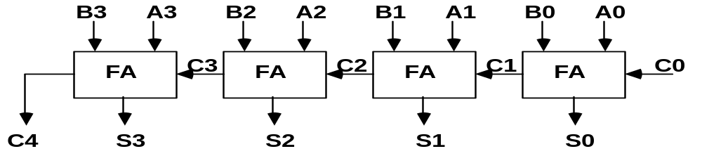
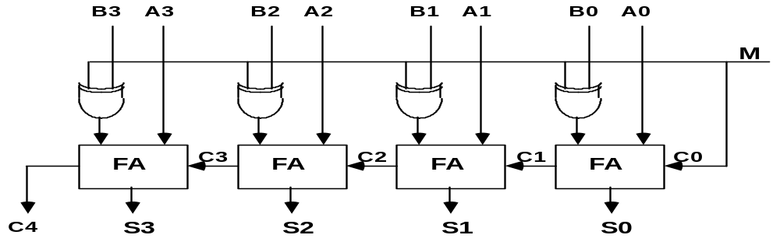
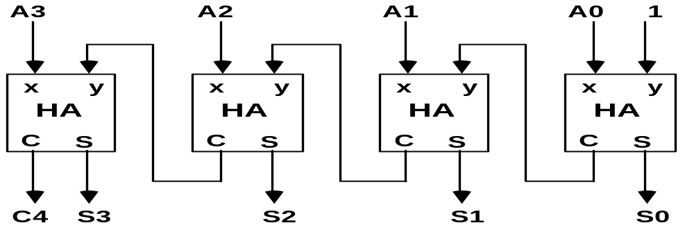
BINARY ADDER / SUBTRACTOR / INCREMENTER
Binary Adder
Binary Adder-Subtractor
Binary Incrementer

Slide 24
ARITHMETIC CIRCUIT
Cin
S1
S0
A0
X0
C0
S1
FA
D0
B0
S0
4x1
Y0
C1
0
1
MUX
2
3
A1
X1
C1
S1
FA
D1
B1
S0
4x1
Y1
C2
0
1
MUX
2
3
A2
X2
C2
S1
FA
D2
B2
S0
4x1
Y2
C3
0
1
MUX
2
3
A3
X3
C3
S1
FA
D3
B3
S0
4x1
Y3
C4
0
1
MUX
2
Cout
0
1
3
S1 S0 Cin Y Output Microoperation
0 0 0 B D = A + B Add
0 0 1 B D = A + B + 1 Add with carry
0 1 0 B’ D = A + B’ Subtract with borrow
0 1 1 B’ D = A + B’+ 1 Subtract
1 0 0 0 D = A Transfer A
1 0 1 0 D = A + 1 Increment A
1 1 0 1 D = A - 1 Decrement A
1 1 1 1 D = A Transfer A

Slide 25
LOGIC MICROOPERATIONS
It specifies binary operations on the strings of bits stored in registers
  Logic microoperations are bit-wise operations, i.e., they work on the individual bits of data
  useful for bit manipulations on binary data
  useful for making logical decisions based on the bit value
There are, in principle, 16 different logic functions that can be defined over two binary input variables
However, most systems only implement four of these
  AND (∧), OR (∨), XOR (⊕), Complement/NOT
The others can be created from combination of these
A B F₀ F₁ F₂ … F₁₃ F₁₄ F₁₅
0 0 0 0 0 … 1 1 1
0 1 0 0 0 … 1 1 1
1 0 0 0 1 … 0 1 1
1 1 0 1 0 … 1 0 1

Slide 26
LIST OF LOGIC MICROOPERATIONS
Logic Microoperations
List of Logic Microoperations
- 16 different logic operations with 2 binary vars.
- n binary vars → functions
2
2
n
Truth tables for 16 functions of 2 variables and the
corresponding 16 logic micro-operations
x 0 0 1 1
y 0 1 0 1
Boolean
Function
Micro-
Operations
Name
  0 0 0 0 F0 = 0 F ← 0 Clear
  0 0 0 1 F1 = xy F ← A ∧ B AND
  0 0 1 0 F2 = xy' F ← A ∧ B’
  0 0 1 1 F3 = x F ← A Transfer A
  0 1 0 0 F4 = x'y F ← A’∧ B
  0 1 0 1 F5 = y F ← B Transfer B
  0 1 1 0 F6 = x ⊕ y F ← A ⊕ B Exclusive-OR
  0 1 1 1 F7 = x + y F ← A ∨ B OR
  1 0 0 0 F8 = (x + y)' F ← (A ∨ B)’ NOR
  1 0 0 1 F9 = (x ⊕ y)' F ← (A ⊕ B)’ Exclusive-NOR
  1 0 1 0 F10 = y' F ← B’ Complement B
  1 0 1 1 F11 = x + y' F ← A ∨ B
  1 1 0 0 F12 = x' F ← A’ Complement A
  1 1 0 1 F13 = x' + y F ← A’∨ B
  1 1 1 0 F14 = (xy)' F ← (A ∧ B)’ NAND
  1 1 1 1 F15 = 1 F ← all 1's Set to all 1's

Slide 27
HARDWARE IMPLEMENTATION OF LOGIC MICROOPERATIONS
A
i
0
B
i
1
4 X 1
F
MUX
i
2
3
Select
S
1
S
0
Function table
S₁ S₀
Output
μ-operation
0 0 F = A ∧ B AND
0 1 F = A ∨ B OR
1 0 F = A ⊕ B XOR
1 1 F = A’ Complement

Slide 28
APPLICATIONS OF LOGIC MICROOPERATIONS
Logic micro operations can be used to manipulate individual bits or a portions of a word in a register
Consider the data in a register A. In another register, B, is bit data that will be used to modify the contents of A
- Selective-set A ← A + B
  Selective-complement A ← A ⊕ B
  Selective-clear A ← A • B’
  Mask (Delete) A ← A • B
  Clear A ← A ⊕ B
  Insert A ← (A • B) + C
  Compare A ← A ⊕ B
  . . .

Slide 29
SELECTIVE SET
In a selective set operation, the bit pattern in B is used to set certain bits in A
1 1 0 0 A_{t}
1 0 1 0 B
1 1 1 0 A_{t+1} (A ← A + B)
If a bit in B is set to 1, that same position in A gets set to 1, otherwise that bit in A keeps its previous value

Slide 30
SELECTIVE COMPLEMENT
In a selective complement operation, the bit pattern in B is used to complement certain bits in A
1 1 0 0 A_{t}
1 0 1 0 B
0 1 1 0 A_{t+1} (A ← A ⊕ B)
If a bit in B is set to 1, that same position in A gets complemented from its original value, otherwise it is unchanged

Slide 31
SELECTIVE CLEAR
In a selective clear operation, the bit pattern in B is used to clear certain bits in A
1 1 0 0 A_{t}
1 0 1 0 B
0 1 0 0 A_{t+1} (A ← A ⋅ B’)
If a bit in B is set to 1, that same position in A gets set to 0, otherwise it is unchanged

Slide 32
MASK OPERATION
In a mask operation, the bit pattern in B is used to clear certain bits in A
1 1 0 0 A_{t}
1 0 1 0 B
1 0 0 0 A_{t+1} (A ← A ⋅ B)
If a bit in B is set to 0, that same position in A gets set to 0, otherwise it is unchanged

Slide 33
CLEAR OPERATION
In a clear operation, if the bits in the same position in A and B are the same, they are cleared in A, otherwise they are set in A
1 1 0 0 A_{t}
1 0 1 0 B
0 1 1 0 A_{t+1} (A ← A ⊕ B)

Slide 34
INSERT OPERATION
An insert operation is used to introduce a specific bit pattern into A register, leaving the other bit positions unchanged
This is done as
  A mask operation to clear the desired bit positions, followed by
  An OR operation to introduce the new bits into the desired positions

Slide 35
  Example
    Suppose you wanted to introduce 1010 into the low order four bits of A: 1101 1000 1011 0001 A (Original) 1101 1000 1011 1010 A (Desired)
    1101 1000 1011 0001 A (Original)
    1111 1111 1111 0000 Mask
    1101 1000 1011 0000 A (Intermediate)
    0000 0000 0000 1010 Added bits
    1101 1000 1011 1010 A (Desired)

Slide 36
SHIFT MICROOPERATIONS
Shift microoperations are used for serial transfer of data.
The information transferred through the serial input determines the type of shift. There are three types of shifts
  Logical shift
  Circular shift
  Arithmetic shift
A right shift operation
A left shift operation
Serial
input
Serial
input

Slide 37
LOGICAL SHIFT
In a logical shift the serial input to the shift is a 0.
A right logical shift operation:
A left logical shift operation:
In a Register Transfer Language, the following notation is used
  shl for a logical shift left
  shr for a logical shift right
  Examples:
    R2 ← shr R2
    R3 ← shl R3
0
0

Slide 38
CIRCULAR SHIFT
In a circular shift the serial input is the bit that is shifted out of the other end of the register.
A right circular shift operation:
A left circular shift operation:
In a RTL, the following notation is used
  cil for a circular shift left
  cir for a circular shift right
  Examples:
    R2 ← cir R2
    R3 ← cil R3

Slide 39
ARITHMETIC SHIFT
An arithmetic shift is meant for signed binary numbers (integer)
An arithmetic left shift multiplies a signed number by two
An arithmetic right shift divides a signed number by two
The main distinction of an arithmetic shift is that it must keep the sign of the number the same as it performs the multiplication or division
A right arithmetic shift operation:
A left arithmetic shift operation:
sign
bit
0
sign
bit

Slide 40
ARITHMETIC SHIFT
An left arithmetic shift operation must be checked for the overflow
0
sign
bit
Before the shift, if the leftmost two
bits differ, the shift will result in an
overflow
V
In a RTL, the following notation is used
  ashl for an arithmetic shift left
  ashr for an arithmetic shift right
  Examples:
    R2 ← ashr R2
    R3 ← ashl R3

Slide 41
HARDWARE IMPLEMENTATION OF SHIFT MICROOPERATIONS
Serial
input (I_{R})
Select
0 for shift right (down)
1 for shift left (up)
S
H0
0
MUX
1
A0
A1
S
H1
0
MUX
A2
1
A3
S
0
MUX
H2
1
S
H3
0
MUX
1
Serial
input (I_{L})

Slide 42
ARITHMETIC LOGIC SHIFT UNIT
S3
S2
C
S1
i
S0
D
Arithmetic
i
Circuit
Select
C
0
4 x 1
F
i+1
1
MUX
i
2
3
Logic
E
B
i
i
Circuit
A
i
shr
A
i-1
shl
A
i+1
  S3 S2 S1 S0 Cin Operation Function
  0 0 0 0 0 F = A Transfer A
  0 0 0 0 1 F = A + 1 Increment A
  0 0 0 1 0 F = A + B Addition
  0 0 0 1 1 F = A + B + 1 Add with carry
  0 0 1 0 0 F = A + B’ Subtract with borrow
  0 0 1 0 1 F = A + B’+ 1 Subtraction
  0 0 1 1 0 F = A - 1 Decrement A
  0 0 1 1 1 F = A TransferA
  0 1 0 0 X F = A ∧ B AND
  0 1 0 1 X F = A ∨ B OR
  0 1 1 0 X F = A ⊕ B XOR
  0 1 1 1 X F = A’ Complement A
  1 0 X X X F = shr A Shift right A into F
  1 1 X X X F = shl A Shift left A into F

Slide 43
BASIC COMPUTER ORGANIZATION AND DESIGN
• Instruction Codes
• Computer Registers
• Computer Instructions
• Timing and Control
• Instruction Cycle
• Memory Reference Instructions
• Input-Output and Interrupt
• Complete Computer Description
• Design of Basic Computer
• Design of Accumulator Logic

Slide 44
Instruction Codes
Every different processor type has its own design (different registers, buses, microoperations, machine instructions, etc)
Modern processor is a very complex device
It contains
  Many registers
  Multiple arithmetic units, for both integer and floating point calculations
  The ability to pipeline several consecutive instructions to speed execution
  Etc.
However, to understand how processors work, we will start with a simplified processor model
This is similar to what real processors were like ~25 years ago
M. Morris Mano introduces a simple processor model he calls the Basic Computer
We will use this to introduce processor organization and the relationship of the RTL model to the higher level computer processor

Slide 45
THE BASIC COMPUTER
The Basic Computer has two components, a processor and memory
The memory has 4096 words in it
  4096 = 2¹², so it takes 12 bits to select a word in memory
Each word is 16 bits long
CPU
RAM
0
15
0
4095

Slide 46
INSTRUCTIONS
Instruction codes
Program
  A sequence of (machine) instructions
(Machine) Instruction
  A group of bits that tell the computer to perform a specific operation (a sequence of micro-operation)
The instructions of a program, along with any needed data are stored in memory
The CPU reads the next instruction from memory
It is placed in an Instruction Register (IR)
Control circuitry in control unit then translates the instruction into the sequence of microoperations necessary to implement it

Slide 47
INSTRUCTION FORMAT
Instruction codes
A computer instruction is often divided into two parts
  An opcode (Operation Code) that specifies the operation for that instruction
  An address that specifies the registers and/or locations in memory to use for that operation
In the Basic Computer, since the memory contains 4096 (= 2¹²) words, we needs 12 bit to specify which memory address this instruction will use
In the Basic Computer, bit 15 of the instruction specifies the addressing mode (0: direct addressing, 1: indirect addressing)
Since the memory words, and hence the instructions, are 16 bits long, that leaves 3 bits for the instruction’s opcode
Instruction Format
15
14
12
11
0
I
Opcode
Address
Addressing
mode

Slide 48
ADDRESSING MODES
Instruction codes
The address field of an instruction can represent either
  Direct address: the address in memory of the data to use (the address of the operand), or
  Indirect address: the address in memory of the address in memory of the data to use
Effective Address (EA)
  The address, that can be directly used without modification to access an operand for a computation-type instruction, or as the target address for a branch-type instruction
Direct addressing
Indirect addressing
22
0
ADD
457
35
1
ADD
300
300
1350
457
Operand
1350
Operand
+
+
AC
AC

Slide 49
PROCESSOR REGISTERS
Instruction codes
A processor has many registers to hold instructions, addresses, data, etc
The processor has a register, the Program Counter (PC) that holds the memory address of the next instruction to get
  Since the memory in the Basic Computer only has 4096 locations, the PC only needs 12 bits
In a direct or indirect addressing, the processor needs to keep track of what locations in memory it is addressing: The Address Register (AR) is used for this
  The AR is a 12 bit register in the Basic Computer
When an operand is found, using either direct or indirect addressing, it is placed in the Data Register (DR). The processor then uses this value as data for its operation
The Basic Computer has a single general purpose register – the Accumulator (AC)

Slide 50
PROCESSOR REGISTERS
Instruction codes
The significance of a general purpose register is that it can be referred to in instructions
  e.g. load AC with the contents of a specific memory location; store the contents of AC into a specified memory location
Often a processor will need a scratch register to store intermediate results or other temporary data; in the Basic Computer this is the Temporary Register (TR)
The Basic Computer uses a very simple model of input/output (I/O) operations
  Input devices are considered to send 8 bits of character data to the processor
  The processor can send 8 bits of character data to output devices
The Input Register (INPR) holds an 8 bit character gotten from an input device
The Output Register (OUTR) holds an 8 bit character to be send to an output device

Slide 51
COMPUTER REGISTERS
Registers
Registers in the Basic Computer
11
0
PC
Memory
11
0
4096 x 16
AR
15
0
IR
CPU
15
0
15
0
TR
DR
7
0
7
0
15
0
OUTR
INPR
AC
List of BC Registers
  DR 16 Data Register Holds memory operand
  AR 12 Address Register Holds address for memory
  AC 16 Accumulator Processor register
  IR 16 Instruction Register Holds instruction code
  PC 12 Program Counter Holds address of instruction
  TR 16 Temporary Register Holds temporary data
  INPR 8 Input Register Holds input character
  OUTR 8 Output Register Holds output character

Slide 52
COMMON BUS SYSTEM
Registers
The registers in the Basic Computer are connected using a bus
This gives a savings in circuitry over complete connections between registers

Slide 53
COMMON BUS SYSTEM
Registers
S2
S1
Bus
S0
Memory unit
7
4096 x 16
Address
Write
Read
AR
1
LD INR CLR
PC
2
LD INR CLR
DR
3
LD INR CLR
E
ALU
AC
4
LD INR CLR
INPR
IR
5
LD
TR
6
LD INR CLR
OUTR
Clock
LD
16-bit common bus

Slide 54
COMMON BUS SYSTEM
Registers
Read
INPR
Memory
4096 x 16
Write
Address
E
ALU
AC
L
I
C
L
I
C
L
L
I
C
DR
IR
L
I
C
PC
TR
AR
OUTR
LD
L
I
C
7
1
2
3
4
5
6
16-bit Common Bus
S₀
S₁
S₂

Slide 55
COMMON BUS SYSTEM
Registers
Three control lines, S₂, S₁, and S₀ control which register the bus selects as its input
Either one of the registers will have its load signal activated, or the memory will have its read signal activated
  Will determine where the data from the bus gets loaded
The 12-bit registers, AR and PC, have 0’s loaded onto the bus in the high order 4 bit positions
When the 8-bit register OUTR is loaded from the bus, the data comes from the low order 8 bits on the bus
S₂ S₁ S₀ Register
0 0 0 x
0 0 1 AR
0 1 0 PC
0 1 1 DR
1 0 0 AC
1 0 1 IR
1 1 0 TR
1 1 1 Memory

Slide 56
COMPUTER INSTRUCTIONS
Instructions
Basic Computer Instruction Format
Memory-Reference Instructions (OP-code = 000 ~ 110)
15 14
12 11
0
I
Opcode
Address
Register-Reference Instructions (OP-code = 111, I = 0)
15
12 11
0
0 1 1 1
Register operation
Input-Output Instructions (OP-code =111, I = 1)
15
12 11
0
1 1 1 1
I/O operation

Slide 57
BASIC COMPUTER INSTRUCTIONS
Instructions
Hex Code
Symbol I = 0 I = 1 Description
  AND 0xxx 8xxx AND memory word to AC
  ADD 1xxx 9xxx Add memory word to AC
  LDA 2xxx Axxx Load AC from memory
  STA 3xxx Bxxx Store content of AC into memory
  BUN 4xxx Cxxx Branch unconditionally
  BSA 5xxx Dxxx Branch and save return address
  ISZ 6xxx Exxx Increment and skip if zero
  CLA 7800 Clear AC
  CLE 7400 Clear E
  CMA 7200 Complement AC
  CME 7100 Complement E
  CIR 7080 Circulate right AC and E
  CIL 7040 Circulate left AC and E
  INC 7020 Increment AC
  SPA 7010 Skip next instr. if AC is positive
  SNA 7008 Skip next instr. if AC is negative
  SZA 7004 Skip next instr. if AC is zero
  SZE 7002 Skip next instr. if E is zero
  HLT 7001 Halt computer
  INP F800 Input character to AC
  OUT F400 Output character from AC
  SKI F200 Skip on input flag
  SKO F100 Skip on output flag
  ION F080 Interrupt on
  IOF F040 Interrupt off

Slide 58
INSTRUCTION SET COMPLETENESS
Instructions
A computer should have a set of instructions so that the user can
construct machine language programs to evaluate any function that is known to be computable.
Instruction Types
  Functional Instructions
  - Arithmetic, logic, and shift instructions
  - ADD, CMA, INC, CIR, CIL, AND, CLA
  Transfer Instructions
  - Data transfers between the main memory
  and the processor registers
  - LDA, STA
  Control Instructions
  - Program sequencing and control
  - BUN, BSA, ISZ
  Input/Output Instructions
  - Input and output
  - INP, OUT

Slide 59
CONTROL UNIT
Instruction codes
Control unit (CU) of a processor translates from machine instructions to the control signals for the microoperations that implement them
Control units are implemented in one of two ways
Hardwired Control
  CU is made up of sequential and combinational circuits to generate the control signals
Microprogrammed Control
  A control memory on the processor contains microprograms that activate the necessary control signals
We will consider a hardwired implementation of the control unit for the Basic Computer

Slide 60
TIMING AND CONTROL
Timing and control
Control unit of Basic Computer
Instruction register (IR)
15
14 13 12
11 - 0
Other inputs
3 x 8
decoder
7 6 5 4 3 2 1 0
D
0
Combinational
Control
logic
I
D
Control
signals
7
T
15
T
0
15 14 . . . . 2 1 0
4 x 16
decoder
4-bit
Increment (INR)
sequence
Clear (CLR)
counter
Clock
(SC)

Slide 61
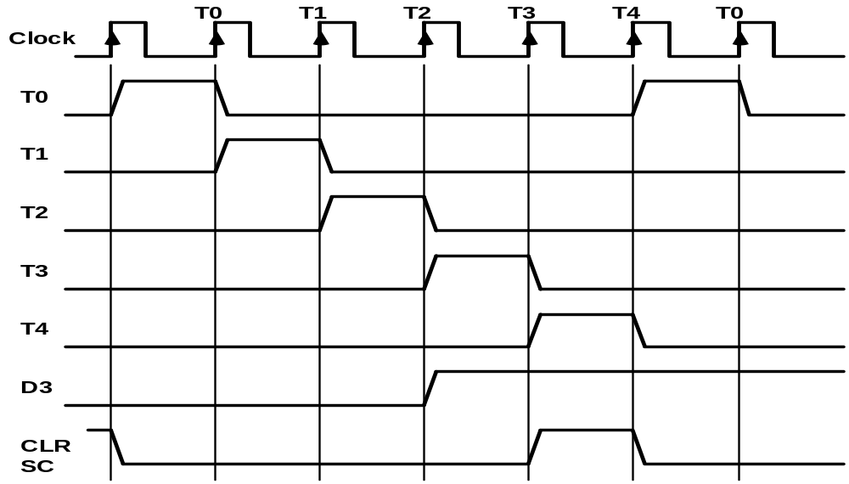
TIMING SIGNALS
Timing and control
- Generated by 4-bit sequence counter and 4×16 decoder
- The SC can be incremented or cleared.
- Example: T₀, T₁, T₂, T₃, T₄, T₀, T₁, . . .
Assume: At time T₄, SC is cleared to 0 if decoder output D3 is active.
D₃T₄: SC ← 0

Slide 62
INSTRUCTION CYCLE
In Basic Computer, a machine instruction is executed in the following cycle:
  Fetch an instruction from memory
  Decode the instruction
  Read the effective address from memory if the instruction has an indirect address
  Execute the instruction
After an instruction is executed, the cycle starts again at step 1, for the next instruction
Note: Every different processor has its own (different) instruction cycle

Slide 63
FETCH and DECODE
Instruction Cycle
• Fetch and Decode
T0: AR ← PC (S₀S₁S₂=010, T0=1)
T1: IR ← M [AR], PC ← PC + 1 (S0S1S2=111, T1=1)
T2: D0, . . . , D7 ← Decode IR(12-14), AR ← IR(0-11), I ← IR(15)
T1
S₂
T0
S₁
Bus
S₀
Memory
7
unit
Address
Read
AR
1
LD
PC
2
INR
IR
5
LD
Clock
Common bus

Slide 64
DETERMINE THE TYPE OF INSTRUCTION
Instrction Cycle
Start
SC ← 0
AR
←
PC
T0
T1
IR
←
M[AR],
PC
←
PC + 1
T2
Decode Opcode in IR(12-14),
AR
←
IR(0-11),
←
I
IR(15)
(Register or I/O) = 1
D7
= 0 (Memory-reference)
(I/O) = 1
= 0 (register)
(indirect) = 1
= 0 (direct)
I
I
T3
T3
T3
T3
Execute
Execute
AR
←
M[AR]
Nothing
input-output
register-reference
instruction
instruction
SC
←
0
SC
←
0
Execute
T4
memory-reference
instruction
SC
←
0
D'7IT3: AR ← M[AR]
D'7I'T3: Nothing
D7I'T3: Execute a register-reference instr.
D7IT3: Execute an input-output instr.

Slide 65
REGISTER REFERENCE INSTRUCTIONS
Instruction Cycle
Register Reference Instructions are identified when
- D₇ = 1, I = 0
- Register Ref. Instr. is specified in b₀ ~ b₁₁ of IR
- Execution starts with timing signal T₃
r = D₇ I′T₃ => Register Reference Instruction
B_{i} = IR(i) , i=0,1,2,...,11
r: SC ← 0
CLA rB₁₁: AC ← 0
CLE rB₁₀: E ← 0
CMA rB₉: AC ← AC’
CME rB₈: E ← E’
CIR rB₇: AC ← shr AC, AC(15) ← E, E ← AC(0)
CIL rB₆: AC ← shl AC, AC(0) ← E, E ← AC(15)
INC rB₅: AC ← AC + 1
SPA rB₄: if (AC(15) = 0) then (PC ← PC+1)
SNA rB₃: if (AC(15) = 1) then (PC ← PC+1)
SZA rB₂: if (AC = 0) then (PC ← PC+1)
SZE rB₁: if (E = 0) then (PC ← PC+1)
HLT rB₀: S ← 0 (S is a start-stop flip-flop)

Slide 66
MEMORY REFERENCE INSTRUCTIONS
MR Instructions
Symbol
Operation
Decoder
Symbolic Description
AND D₀ AC ← AC ∧ M[AR]
ADD D₁ AC ← AC + M[AR], E ← C_{out}
LDA D₂ AC ← M[AR]
STA D₃ M[AR] ← AC
BUN D₄ PC ← AR
BSA D₅ M[AR] ← PC, PC ← AR + 1
ISZ D₆ M[AR] ← M[AR] + 1, if M[AR] + 1 = 0 then PC ← PC+1
- The effective address of the instruction is in AR and was placed there during
timing signal T₂ when I = 0, or during timing signal T₃ when I = 1
- Memory cycle is assumed to be short enough to complete in a CPU cycle
- The execution of MR instruction starts with T₄
AND to AC
D₀T₄: DR ← M[AR] Read operand
D₀T₅: AC ← AC ∧ DR, SC ← 0 AND with AC
ADD to AC
D₁T₄: DR ← M[AR] Read operand
D₁T₅: AC ← AC + DR, E ← C_{out}, SC ← 0 Add to AC and store carry in E

Slide 67
MEMORY REFERENCE INSTRUCTIONS
LDA: Load to AC
D₂T₄: DR ← M[AR]
D₂T₅: AC ← DR, SC ← 0
STA: Store AC
D₃T₄: M[AR] ← AC, SC ← 0
BUN: Branch Unconditionally
D₄T₄: PC ← AR, SC ← 0
BSA: Branch and Save Return Address
M[AR] ← PC, PC ← AR + 1
Memory, PC, AR at time T4
Memory, PC after execution
20
0
BSA
135
20
0
BSA
135
PC = 21
Next instruction
21
Next instruction
AR = 135
135
21
136
Subroutine
PC = 136
Subroutine
1
BUN
135
1
BUN
135
Memory
Memory

Slide 68
MEMORY REFERENCE INSTRUCTIONS
MR Instructions
BSA:
D₅T₄: M[AR] ← PC, AR ← AR + 1
D₅T₅: PC ← AR, SC ← 0
ISZ: Increment and Skip-if-Zero
D₆T₄: DR ← M[AR]
D₆T₅: DR ← DR + 1
D₆T₄: M[AR] ← DR, if (DR = 0) then (PC ← PC + 1), SC ← 0

Slide 69
FLOWCHART FOR MEMORY REFERENCE INSTRUCTIONS
MR Instructions
Memory-reference instruction
AND
ADD
LDA
STA
D T
D T
D T
D T
0
4
1
4
2
4
3
4
DR ← M[AR]
DR ← M[AR]
DR ← M[AR]
M[AR] ← AC
SC ← 0
D T
D T
D T
0
5
1
5
2
5
∧
AC ← AC DR
AC ← AC + DR
AC ← DR
SC ← 0
E ← Cout
SC ← 0
SC ← 0
BUN
BSA
ISZ
D T
D T
D T
4
4
5
4
6
4
PC ← AR
M[AR] ← PC
DR ← M[AR]
SC ← 0
AR ← AR + 1
D T
D T
5
5
6
5
PC ← AR
DR ← DR + 1
SC ← 0
D T
6
6
M[AR] ← DR
If (DR = 0)
then (PC ← PC + 1)
SC ← 0

Slide 70
INPUT-OUTPUT AND INTERRUPT
I/O and Interrupt
A Terminal with a keyboard and a Printer
Input-Output Configuration
Input-output
Serial
Computer
registers and
flip-flops
terminal
communication
interface
Printer
Receiver
OUTR
FGO
interface
AC
Keyboard
Transmitter
INPR
FGI
INPR Input register - 8 bits
OUTR Output register - 8 bits
FGI Input flag - 1 bit
FGO Output flag - 1 bit
IEN Interrupt enable - 1 bit
interface
Serial Communications Path
Parallel Communications Path
- The terminal sends and receives serial information
- The serial info. from the keyboard is shifted into INPR
- The serial info. for the printer is stored in the OUTR
- INPR and OUTR communicate with the terminal
serially and with the AC in parallel.
- The flags are needed to synchronize the timing
difference between I/O device and the computer

Slide 71
PROGRAM CONTROLLED DATA TRANSFER
I/O and Interrupt
-- CPU -- -- I/O Device --
/* Input */ /* Initially FGI = 0 */
loop: If FGI = 0 goto loop
AC ← INPR, FGI ← 0
/* Output */ /* Initially FGO = 1 */
loop: If FGO = 0 goto loop
OUTR ← AC, FGO ← 0
loop: If FGI = 1 goto loop
INPR ← new data, FGI ← 1
loop: If FGO = 1 goto loop
consume OUTR, FGO ← 1
FGI=0
FGO=1
Start Input
Start Output
FGI ← 0
AC ← Data
yes
FGI=0
yes
FGO=0
no
no
AC ← INPR
OUTR ← AC
yes
More
Character
FGO ← 0
yes
More
Character
no
END
no
END

Slide 72
INPUT-OUTPUT INSTRUCTIONS
D₇IT₃ = p
IR(i) = B_{i}, i = 6, …, 11
p: SC ← 0 Clear SC
INP pB₁₁: AC(0-7) ← INPR, FGI ← 0 Input char. to AC
OUT pB₁₀: OUTR ← AC(0-7), FGO ← 0 Output char. from AC
SKI pB₉: if(FGI = 1) then (PC ← PC + 1) Skip on input flag
SKO pB₈: if(FGO = 1) then (PC ← PC + 1) Skip on output flag
ION pB₇: IEN ← 1 Interrupt enable on
IOF pB₆: IEN ← 0 Interrupt enable off

Slide 73
PROGRAM-CONTROLLED INPUT/OUTPUT
I/O and Interrupt
Program-controlled I/O
- Continuous CPU involvement
I/O takes valuable CPU time
- CPU slowed down to I/O speed
- Simple
- Least hardware
Input
LOOP, SKI DEV
BUN LOOP
INP DEV
Output
LOOP, LDA DATA
LOP, SKO DEV
BUN LOP
OUT DEV

Slide 74
INTERRUPT INITIATED INPUT/OUTPUT
- Open communication only when some data has to be passed --> interrupt.
- The I/O interface, instead of the CPU, monitors the I/O device.
- When the interface founds that the I/O device is ready for data transfer,
it generates an interrupt request to the CPU
- Upon detecting an interrupt, the CPU stops momentarily the task
it is doing, branches to the service routine to process the data
transfer, and then returns to the task it was performing.
* IEN (Interrupt-enable flip-flop)
- can be set and cleared by instructions
- when cleared, the computer cannot be interrupted

Slide 75
FLOWCHART FOR INTERRUPT CYCLE
I/O and Interrupt
R = Interrupt f/f
Instruction cycle
=0
R
=1
Interrupt cycle
Fetch and decode
Store return address
instructions
in location 0
M[0] ← PC
Execute
IEN
=0
instructions
=1
Branch to location 1
=1
PC ← 1
FGI
=0
=1
FGO
IEN ← 0
R ← 0
=0
R ← 1
- The interrupt cycle is a HW implementation of a branch
and save return address operation.
- At the beginning of the next instruction cycle, the
instruction that is read from memory is in address 1.
- At memory address 1, the programmer must store a branch instruction
that sends the control to an interrupt service routine
- The instruction that returns the control to the original
program is "indirect BUN 0"

Slide 76
REGISTER TRANSFER OPERATIONS IN INTERRUPT CYCLE
I/O and Interrupt
Memory
Before interrupt
After interrupt cycle
0
0
256
1
0
BUN
1120
PC = 1
0
BUN
1120
255
Main
Main
PC = 256
Program
255
Program
256
1120
1120
I/O
I/O
Program
Program
1
BUN
0
1
BUN
0
Register Transfer Statements for Interrupt Cycle
- R F/F ← 1 if IEN (FGI + FGO)T₀′T₁′T₂′
⇔ T₀′T₁′T₂′ (IEN)(FGI + FGO): R ← 1
- The fetch and decode phases of the instruction cycle
must be modified ➔Replace T₀, T₁, T₂ with R'T₀, R'T₁, R'T₂
- The interrupt cycle :
RT₀: AR ← 0, TR ← PC
RT₁: M[AR] ← TR, PC ← 0
RT₂: PC ← PC + 1, IEN ← 0, R ← 0, SC ← 0

Slide 77
FURTHER QUESTIONS ON INTERRUPT
I/O and Interrupt
  How can the CPU recognize the device
  requesting an interrupt ?
  Since different devices are likely to require
  different interrupt service routines, how can
  the CPU obtain the starting address of the
  appropriate routine in each case ?
  Should any device be allowed to interrupt the
  CPU while another interrupt is being serviced ?
  How can the situation be handled when two or
  more interrupt requests occur simultaneously ?

